Slide 1
High-Impact HIV Prevention (HIP) in San Francisco
San Francisco Department of Public Health
September 17, 2014

Slide 2
Welcome!

Slide 3
Today’s Agenda
Overview of HIP and the National HIV/AIDS Strategy (NHAS)
Review of the Local Epidemic
Overview of the San Francisco Jurisdictional Plan
HIP Activity

Slide 4
“Paradigm shift”
“Paradigm shift”- a radical change in underlying beliefs or theory
San Francisco made a “paradigm shift" in 2010
A “change from one way of thinking to another. It's a revolution, a transformation, a sort of metamorphosis. It just does not happen, but rather it is driven by agents of change.”
Thomas Kuhn wrote The Structure of Scientific Revolution, 1962

Slide 5
What has shifted?
Treatment as prevention
Move to structural approach
Increased collaboration (de-siloing)
Increased emphasis on biomedical interventions and other behavioral change (e.g. treatment adherence)
Merging of prevention into medical settings (importance of medical home)
Better use of available data to improve public health
Higher level of accountability

Slide 6
“High-Impact Prevention”
High Impact HIV Prevention builds on the priorities of the National HIV/AIDS Strategy (NHAS), and emphasizes scalable, cost-effective interventions with demonstrated potential to reduce new infections.
This approach is designed to maximize the impact of prevention efforts for all individuals at risk for HIV infection, with a special emphasis on populations at greatest risk of HIV infection.

Slide 7
In Other words…
There is a national emphasis on
data-driven
evidence-based
interventions.
There is sufficient evidence that shows the proposed intervention is likely to have significant impact in the reduction of HIV transmission
The program is designed by studying local epidemiology and targeting for greatest impact

Slide 8
What makes one strategy better than another?
Has the ability to reach a large number of people
Can be effectively combined with other strategies

Slide 9
What makes one strategy better than another?
Is very cost-effective
Is practical to implement
on a large scale, at a
reasonable cost

Slide 10
Why the shift?
HIV is easier to detect HIV and treat than ever
Better testing technologies (rapid, pooling)
New discoveries in HIV medicine
Better treatment for HIV
Virus is more toxic than the meds
Health Care Reform
Integration towards holistic services
Focus resources on highest impact
National HIV/AIDS Strategy has helped to increase political will to focus resources and shift to proven methods to best prevent HIV

Slide 11
CDC defines “evidence-based” as…
Something that has been shown – usually through peer-reviewed literature – to be effective within a certain population.
It is based on data.
It has been rigorously evaluated and shown to work.
(However, you can ADAPT an evidence-based intervention.)

Slide 12
Where do behavioral interventions fit?
Years ago CDC released what they considered to be “evidence-based” interventions: DEBIs. They were all behavioral.
Now, the CDC’s list of supported HIP behavioral interventions is shrinking.
For people living with HIV:
PROMISE, d-up! Mpowerment, Popular Opinion Leader, CLEAR, WILLOW, Healthy Relationships, CONNECT, Partnership for Health (Safer Sex), and START.
For people at risk for HIV:
PROMISE, d-up!, Mpowerment, Popular Opinion Leader, Sister to Sister, Personalized Cognitive Counseling, VOICES/VOCES, Safe in the City, and Many Men, Many Voices.

Slide 13
Where do behavioral interventions fit into HIP?
Now, the HIV prevention toolkit is much bigger
Now High-Impact Interventions include
Behavioral interventions
Public Health Strategies
Structural interventions
Social marketing
Biomedical interventions

Slide 14
www.effectiveinterventions.org

Slide 15
National HIV/AIDS Strategy (NHAS)
- July 2010 -
The nation’s first-ever comprehensive, coordinated HIV/AIDS roadmap, with clear and measurable targets to be achieved by 2015.
4 Goals:
Reducing new HIV infections
Increasing access to care and improving health outcomes for people living with HIV
Reducing HIV-related health disparities
Achieving a more coordinated response to the HIV epidemic

Slide 16
San Francisco’s Experience Implementing the NHAS
The Jurisdictional Plans released in February 2013 spelled out a more upstream, structural approach to HIV prevention.
The goal is to suppress individual and community viral load, thereby improving individual health and reducing HIV transmission risk at the community level.
A primary focus is to scale up a continuum of services for HIV-positive people, from initial diagnosis through accessing and maintaining care and treatment.
We are striving to reduce new HIV infections by 50% by 2017.

Slide 17
Quick Summary
To align with the first 3 NHAS goals, San Francisco is:
Scaling UP services that will reduce community viral load (testing, linkage to HIV primary care, partner services, retention/re-engagement in care, treatment adherence)
Scaling DOWN behaviorally-focused interventions
Scaling UP low-cost, high-impact interventions (condom distribution, syringe access and disposal)
CONTINUING to support successful cost-effective efforts (perinatal prevention, nPEP)
LAUNCHING new services (PrEP)
Internally, SFDPH is working on the 4th NHAS goal to achieve a more coordinated response to the epidemic.

Slide 18
Q&A

Slide 19
Using Surveillance Data to Monitor and Evaluate the Spectrum of Engagement in HIV Care September 17, 2014 Maree Kay Parisi Applied Research, Community Health, Epidemiology and Surveillance Branch

Slide 20
Monitoring and evaluation in the context of NHAS
Reduce new HIV infections
Increase access to care and improve health outcomes
Reduce HIV-related health disparities

Slide 21
New HIV diagnoses, deaths, and prevalence, 2006-2013, San Francisco
Data reported through March 2014

Slide 22
Demographics of People Living with HIV SF 2013, US 2011
Demographics | San Francisco N=15,901 | United States N=898,529
Gender Male Female Trans | 92% 6% 2% | 75% 25% --
Race/Ethnicity White African American Latino Asian/Pacific Islander Native American Other/Unknown | 61% 13% 18% 6% 1% 1% | 33% 43% 20% 1% <1% 2%
Transmission Category MSM MSM/IDU IDU Heterosexual Other/Unidentified | 74% 15% 6% 3% 2% | 43% 5% 13% 19% 20%
SF Data reported through March 2014

Slide 23
New HIV Diagnoses by Risk
Number

Slide 24
New HIV Diagnoses by Age
Number
Year of diagnosis

Slide 25
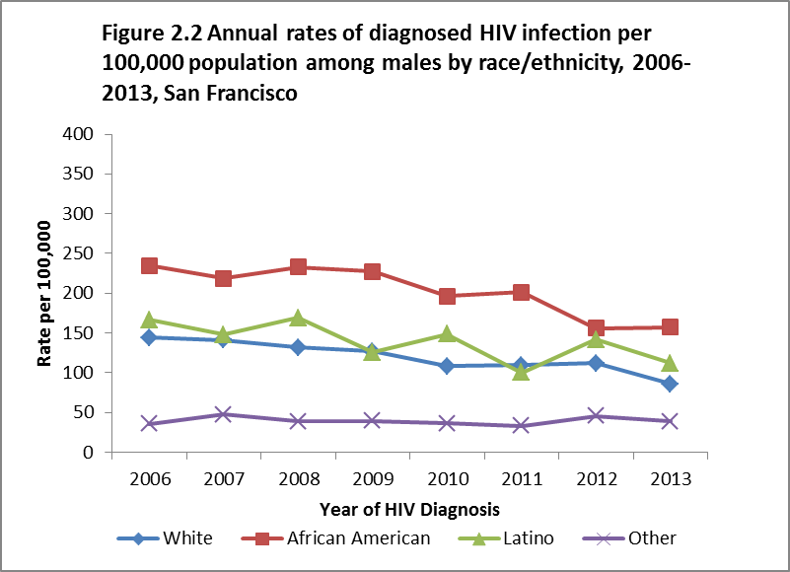

Slide 26
Infection to Diagnosis Step 1

Slide 27
National HIV Behavioral Surveillance 2004-2011, San Francisco
 | HIV- and Risk-Related Variables in 3 Waves Among MSM
Variable | MSM 2004 | MSM 2008 | MSM 2011 | X² Test for Trend
HIV test in last 6 months | 44% | 55% | 58% | <0.001
Unrecognized HIV | 22% | 18% | 7.5% | 0.025
Overall SF: 93% PLWH aware of serostatus
NHAS Target: 90% PLWH aware of serostatus

Slide 28
Trends in median CD4 count at time of diagnosis among persons newly diagnosed with HIV 2007-2011, San Francisco
Diagnosing earlier in the course of HIV disease

Slide 29
Getting from diagnosis to care Step 2

Slide 30
Programs
PHAST: Positive Health Access to Services and Treatment
Launched 2002
Increase HIV testing and linkage to care at SFGH
Interdisciplinary team
LINCS: Linkage, Integration, Navigation, and Comprehensive Services
Post-diagnosis partner services (city-wide), linkage, and retention (SFDPH-wide)

Slide 31
Care and prevention indicators among new HIV diagnoses, San Francisco (Linkage and retention in care)
 | Year of diagnosis
Indicators | 2010 |  | 2011 |  | 2012
Proportion linked to care within 3 months of diagnosis | 84% |  | 86% |  | 89%
Proportion retained in care 3-6 months after linkage | 63% |  | 65% |  | 64%
NHAS linkage to care within 3 months target: 85%

Slide 32
Getting from care to treatment Step 3

Slide 33
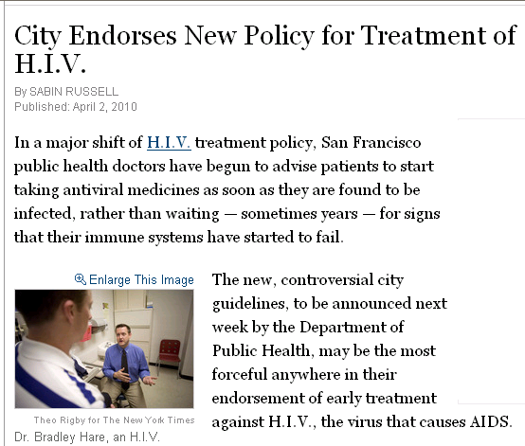
SF: Start Treatment Immediately
BAY AREA REPORTER
SF health officials advise early treatment for people with HIV
by Liz Highleyman
A standing-room only audience packed Carr Auditorium at San Francisco General Hospital on Tuesday to hear about the city's new policy recommending treatment for all people diagnosed with HIV regardless of CD4 T-cell count.
As first described in an April 2 article in the New York Times, the policy change reflects a shift from delaying antiretroviral therapy until a person's immune system sustains significant damage to encouraging everyone to receive treatment as soon as possible.

Slide 34
Estimate of ART use among living HIV cases by nadir CD4 level December 2012, San Francisco

Slide 35
Estimate of ART use among persons living with HIV by demographic, risk and socioeconomic characteristics December 2013, San Francisco
 | Percent Receiving ART
 | Lower Level Estimate |  | Upper Level Estimate
Overall | 84% |  | 91%
Gender
Male | 84% |  | 91%
Female | 81% |  | 86%
Transfemale¹ | 84% |  | 90%
Race/Ethnicity
White | 86% |  | 92%
African American | 81% |  | 87%
Latino | 82% |  | 90%
Asian/Pacific Islander | 79% |  | 88%
Native American | 71% |  | 80%
Multiple race | 79% |  | 85%
Transmission Category
MSM | 85% |  | 91%
PWID | 81% |  | 90%
MSM-PWID | 85% |  | 90%
Heterosexual | 82% |  | 84%
Housing Status, Most Recent
Housed | 86% |  | 91%
Homeless | 63% |  | 76%
Insurance at HIV/AIDS Diagnosis
Private | 89% |  | 94%
Public | 84% |  | 88%
None | 80% |  | 89%
¹ Lower level estimate was calculated among all cases living with HIV (N=15,705). Upper level estimate was calculated among cases who have had following-up information within the last two years and whose chart review was completed between January 2011 and March 2013 (N=8,777). See Technical Notes “Estimate ART Use”.
2 Transfemale data include all transgender cases. Transmale data are not released separately due to the potential small population size.

Slide 36
Disparities: Treatment
Populations less likely to have started treatment
Women
All races compared to white; particularly African-Americans and Native Americans
Heterosexuals and IDU
Homeless
Public or no insurance at diagnosis

Slide 37
Getting from treatment to viral suppression Step 4

Slide 38
Care and prevention indicators among new HIV diagnoses, 2010-2012, San Francisco (Viral suppression)
 | Year
Indicators | 2010 |  | 2011 |  | 2012
Proportion linked to care within 3 months of diagnosis | 84% |  | 86% |  | 89%
Proportion retained in care 3-6 months after linkage | 63% |  | 65% |  | 64%
Proportion virally suppressed within 12 months of diagnosis | 56% |  | 58% |  | 68%

Slide 39
Time from HIV diagnosis to viral suppression, 2008-2012, San Francisco
Year of Dx | Median time to VS (months)
2008 | 13
2009 | 11
2010 | 8
2011 | 6
2012 | 5
Notes:
Need some median times

Slide 40
Disparities: Viral Suppression among New Diagnoses
Characteristics |  |  |  | % Virally suppressed within 12 months of diagnosis²
Total |  |  |  | 68%
Gender
Male |  |  |  | 68%
Female |  |  |  | 59%
Race/Ethnicity
White |  |  |  | 70%
African American |  |  |  | 51%
Latino |  |  |  | 68%
Asian/Pacific Islander |  |  |  | 74%
Other/Unknown |  |  |  | 60%
Age at Diagnosis
13-24 |  |  |  | 59%
25-29 |  |  |  | 61%
30-39 |  |  |  | 75%
40-49 |  |  |  | 69%
50+ |  |  |  | 63%
Transmission Category
MSM |  |  |  | 71%
PWID |  |  |  | 69%
MSM-PWID |  |  |  | 50%
Heterosexual |  |  |  | 62%
Other/Unidentified |  |  |  | 47%

Slide 41
Disparities: Viral Suppression among PLWH¹
Populations less likely to achieve viral suppression (Overall 62%)
Females (57%) , transgender persons (55%)
Current age < 40 years (54%)
African American (58%)
MSM IDU (58%), non-MSM IDU (54%)
Homeless (28%)
¹Alive at end of 2012, most recent viral load in 2012

Slide 42
Spectrum of Engagement in HIV Care
Putting it all together: Cascades

Slide 43
Spectrum of engagement in care among persons diagnosed with HIV, 2009-2012, San Francisco

Slide 44
Summary
San Francisco’s HIV prevention and care indicators are trending in the right direction: towards NHAS targets
Disparities in care and treatment exist by gender, race, risk group, and socioeconomic factors
Programs need to continue focusing on certain groups and hard-to-reach populations to improve indicators

Slide 45
Acknowledgments
ARCHES, SFDPH
Susan Scheer, PhD, MPH
Ling Hsu, MPH
Jennie CS Chin, MBA
Sharon Pipkin, MPH
Center for Public Health Research, SFDPH
Maree.Kay.Parisi@sfdph.org
Link to HIV Epidemiology Section Reports:
http://www.sfdph.org/dph/files/reports/RptsHIVAIDS

Slide 46
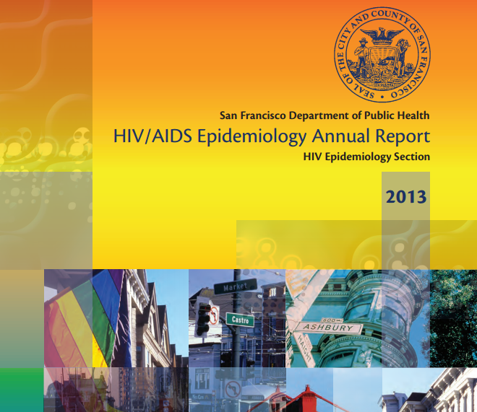
Data Resource
Brand new!
http://www.sfdph.org/ dph/files/reports/ RptsHIVAIDS/ AnnualReport2013.pdf

Slide 47
Q&A

Slide 48
Overview of the San Francisco Jurisdictional Plans, 2012-2016
What is it?
5-year plan (2012-2016) required by CDC
We call it the “SF, San Mateo, Marin HIV Prevention Strategy”
The Strategy outlines “the vision” for HIP in the SF Jurisdiction
The Strategy meets the CDC requirement to develop a Jurisdictional Plan which focus on HIP
Jurisdictional Plan is developed collaboratively with the HIV Prevention Planning Council, other community stakeholders, and DPH
It is updated annually, as needed

Slide 49
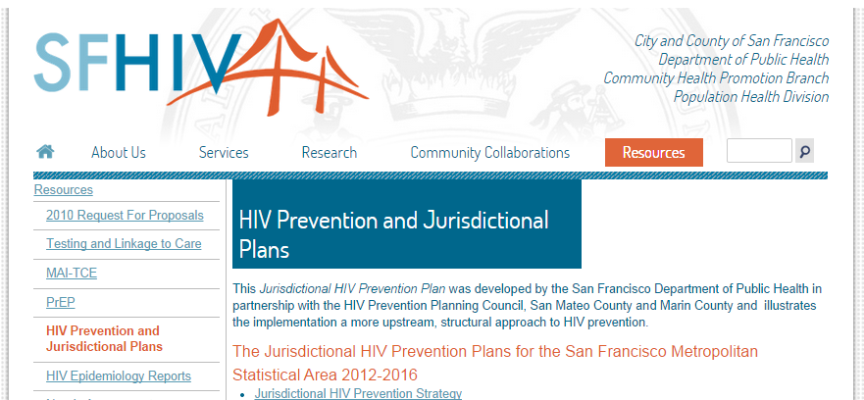
Update to the Plan, August 2014
Both the 2012-2016 Plan and the 2014 annual update can be found here:
http://www.sfhiv.org/resources/hiv-prevention-and-jurisdictional-plans/​

Slide 50
“Any door is the right door”
Continuum of HIV Prevention, Care, &Treatment
Health Outcomes
Comprehensive health screening, assessment, and referral; retention interventions; and risk reduction for people living with and at risk for HIV should be integrated and available within the service system, whether in primary care, community-based services, substance use treatment, or other services.
Any contact with the service system should lead to appropriate linkage to more intensive health-related services, when appropriate. Structural barriers to access must be addressed with creative solutions.
Our goal is healthy people. We envision an SF MSA where there are no new HIV infections and all PLWH have achieved viral suppression.
Screening, Assessment, & Referral
STIs and other co-infections (e.g., hepatitis C)
Mental health & substance use disorders
Trauma history
Basic needs
Sexual & injection risks, as well as risk reduction practices
Resiliency factors
Access to Care & Services
Examples of services:
Linkage support/care navigation
Health Insurance enrollment
Benefits eligibility
Examples of entry points:
(HIV-inclusive) Primary care
HIV testing
Substance use treatment
Mental health services
HIV
Getting to Zero
Zero stigma
Risk Reduction
Retention
Zero new HIV infections
Harm reduction
Mental health & substance use services
Condoms
Syringe access
Sexual health education & risk reduction
Medication adherence
Case management
Linkage to housing & other ancillary services
Mental health & substance use services
Patient navigation
Peer support
Outreach & re-engagement
Appointment reminders
Zero AIDS-related deaths
Post Exposure Prophylaxis (PEP)
Pre Exposure Prophylaxis (PrEP)
Strategies for all, regardless of HIV status
Strategies for HIV negative individuals
Strategies for HIV positive individuals
Health/HIV literacy and education
Antiretroviral therapy

Slide 51
Priority Populations
In SF, the populations that bear the greatest burden of HIV include MSM (with particular attention to Latino and African American MSM), IDU, and TFSM. These groups are estimate to make up 97% of new infections.
For more on disparities review SF Jurisdictional Plan and the 2013 HIV Epidemiology Annual Report.

Slide 52
How San Francisco addresses the NHAS

Slide 53
Future priorities: Testing
Innovative approaches to reach the 6.4% who have HIV and are not aware.
Implement new strategies for increasing HIV testing among IDUs to address high rates of undiagnosed infections.
Implement Determine Combo, the new 4th generation rapid HIV test.

Slide 54
Future priorities: Linkage
Explore same day linkage to care.
Address substance use and mental health barriers to linkage to care.
Address barriers to evening, night, and weekend linkage services.

Slide 55
Future priorities: Integration
Substance use and mental health
Viral Hepatitis
STIs
Overdose Prevention

Slide 56
Q&A
HOW TO USE EFFECTIVE STRATEGIES
How do you select interventions?
How do the NHAS and the SF Jurisdictional Plan work together?
Is your intervention scalable and cost-effective, with demonstrated potential to reduce new infections? How do you figure that out?

Slide 57
Break!

Slide 58
ACTIVITY!
Notes:
SWOT Analysis – breakout into two groups
HANDOUT = case studies (TBD)

Slide 59
A few last thoughts…
Remember, this is the era of HIP.
We have no control over funding decisions for any FOA unless it is released by us! We can only tell you what our approach to high-impact prevention is.
Always follow any FOA instructions very closely. Plan ahead! Some things can’t be done at the
last minute.
Notes:
Follow instructions very closely (Like a requirement to use an intervention from a proposed list, not make up your own.)
Plan ahead! (Letters of Support can take awhile to get. If you need one, make sure you leave enough time so you’re not stuck at the end.)

Slide 60
Resources
Data
CHE&P
Michaela C. Varisto (Ms.)
Executive Assistant
Community Health Equity & Promotion Branch
Population Health Division
25 Van Ness Avenue, Suite 500
San Francisco, CA 94102
Phone: (415) 437-6277
Email: michaela.varisto@sfdph.org

Slide 61
Update to the Plan, August 2014
Both the 2012-2016 Plan and the annual update(s) can be found here:
http://www.sfhiv.org/resources/hiv-prevention-and-jurisdictional-plans/​

Slide 62
www.effectiveinterventions.org

Slide 63
Questions
Applied Research Community health Epidemiology & Surveillance (ARCHES)
Ling Hsu
Ling.Hsu@sfdph.org
Community Health Equity & Promotion (CHE&P)
Michaela C. Varisto
michaela.varisto@sfdph.org

